Slide 1
What is the Seal of God?
Next verse: Revelation 7:3
Notes:
Welcome to our Bible study on the Seal of God! This sealing is mentioned in Revelation 7:1-3.

Slide 2
Revelation 7:3
After these things I saw four angels standing at the four corners of the earth, holding the four winds of the earth, that the wind should not blow on the earth, on the sea, or on any tree. (2) Then I saw another angel ascending from the east, having the seal of the living God. And he cried with a loud voice to the four angels to whom it was granted to harm the earth and the sea, (3) saying, “Do not harm the earth, the sea, or the trees till we have ______ the servants of our God on their _________.”
Notes:
Revelation 7:3
After these things I saw four angels standing at the four corners of the earth, holding the four winds of the earth, that the wind should not blow on the earth, on the sea, or on any tree. (2) Then I saw another angel ascending from the east, having the seal of the living God. And he cried with a loud voice to the four angels to whom it was granted to harm the earth and the sea, (3) saying, “Do not harm the earth, the sea, or the trees till we have sealed the servants of our God on their foreheads.”

Slide 3
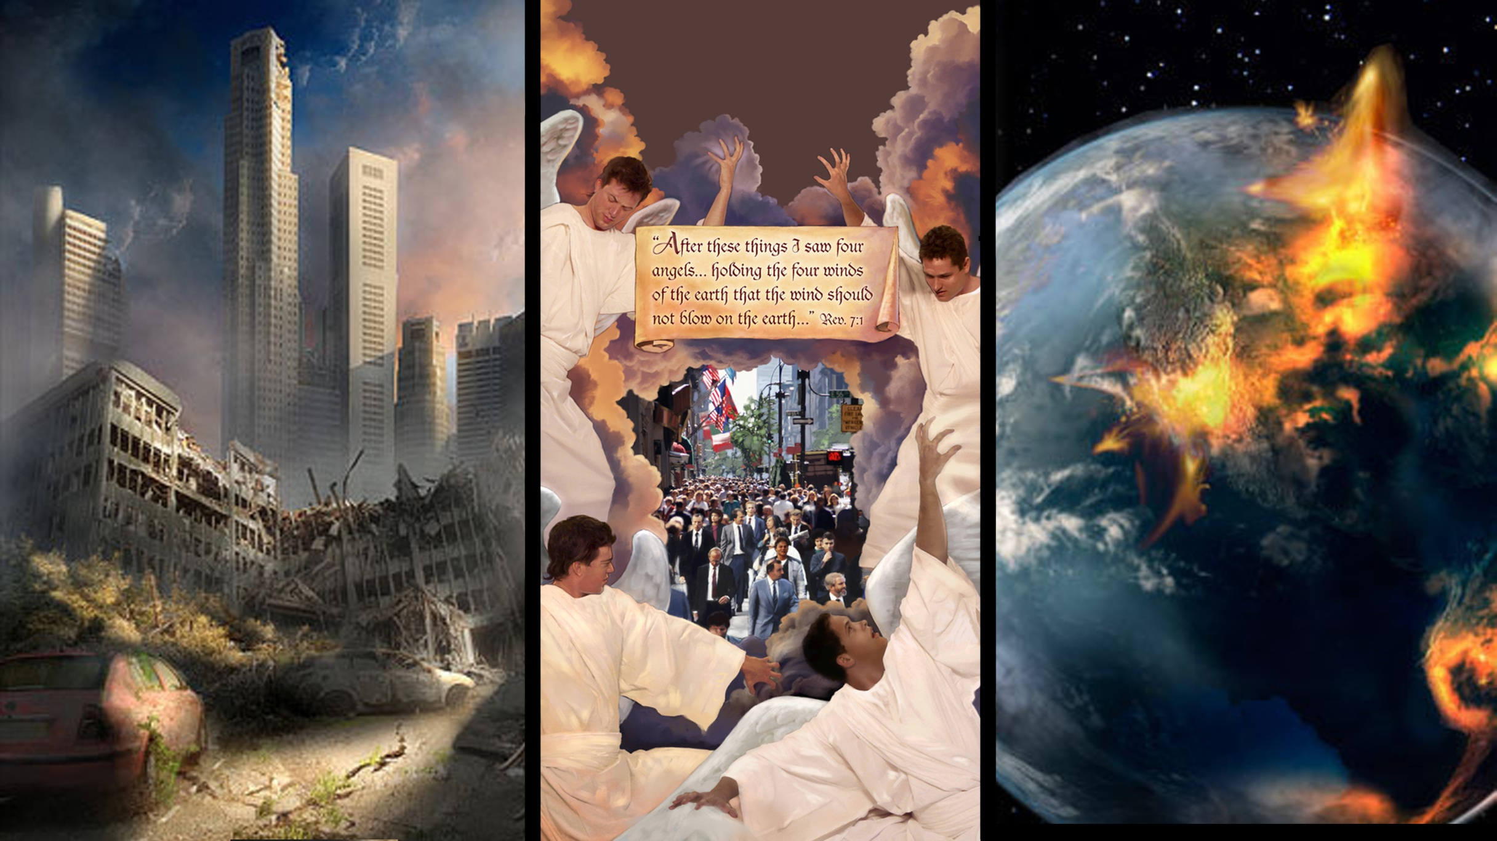
Next verse: Psalm 24:3-5
Notes:
In vision the apostle John sees the elements of nature—political strife, earthquakes, tempests—being held back by four angels. These winds of strife are not released until God gives the word, after His servants are sealed in their foreheads. The mighty angel coming from the east has the seal of the living God, the One alone who can give eternal life and immortality.
Will this seal be placed upon any whose hearts are not pure?

Slide 4
Psalm 24:3-5
Who may ascend into the hill of the Lord? Or who may stand in His holy place? (4) He who has _____ hands and a ____ heart, who has not lifted up his soul to an idol, nor sworn deceitfully. (5) He shall receive blessing from the Lord, and righteousness from the God of his salvation.
Next verse: Matthew 5:8; 1 John 3:2,3
Notes:
Psalm 24:3-5
Who may ascend into the hill of the Lord? Or who may stand in His holy place? (4) He who has clean hands and a pure heart, who has not lifted up his soul to an idol, nor sworn deceitfully. (5) He shall receive blessing from the Lord, and righteousness from the God of his salvation.

Slide 5
Matthew 5:8
Blessed are the ____ in heart, for they shall see ___.
1 John 3:2,3
Beloved, now are we children of God; and it has not yet been revealed what we shall be, but we know that when He is revealed, we shall be ____ Him, for we shall see Him as He is. (3) And everyone who has this hope in Him ________ himself, just as He is pure.
Notes:
Matthew 5:8
Blessed are the pure in heart, for they shall see God.
1 John 3:2,3
Beloved, now are we children of God; and it has not yet been revealed what we shall be, but we know that when He is revealed, we shall be like Him, for we shall see Him as He is. (3) And everyone who has this hope in Him purifies himself, just as He is pure.

Slide 6
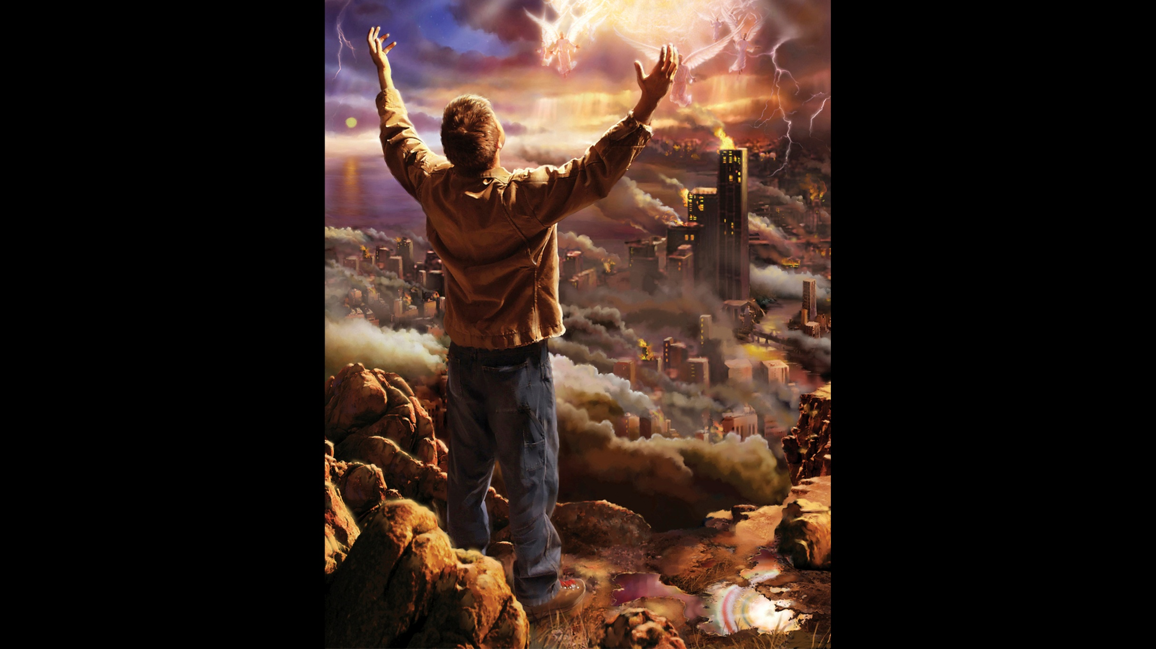
Next verse: 1 Peter 1:22
Notes:
Those who are preparing to meet Jesus and see Him face to face are purifying their hearts now—though the power of Christ overcoming the world, the flesh, and the devil. They are letting go of anything and everything that might stand in the way of full commitment to Jesus.
How does the work of purification take place?

Slide 7
1 Peter 1:22
Since you have purified your souls in _______ the _____ through the Spirit…
Notes:
1 Peter 1:22
Since you have purified your souls in obeying the truth through the Spirit…

Slide 8
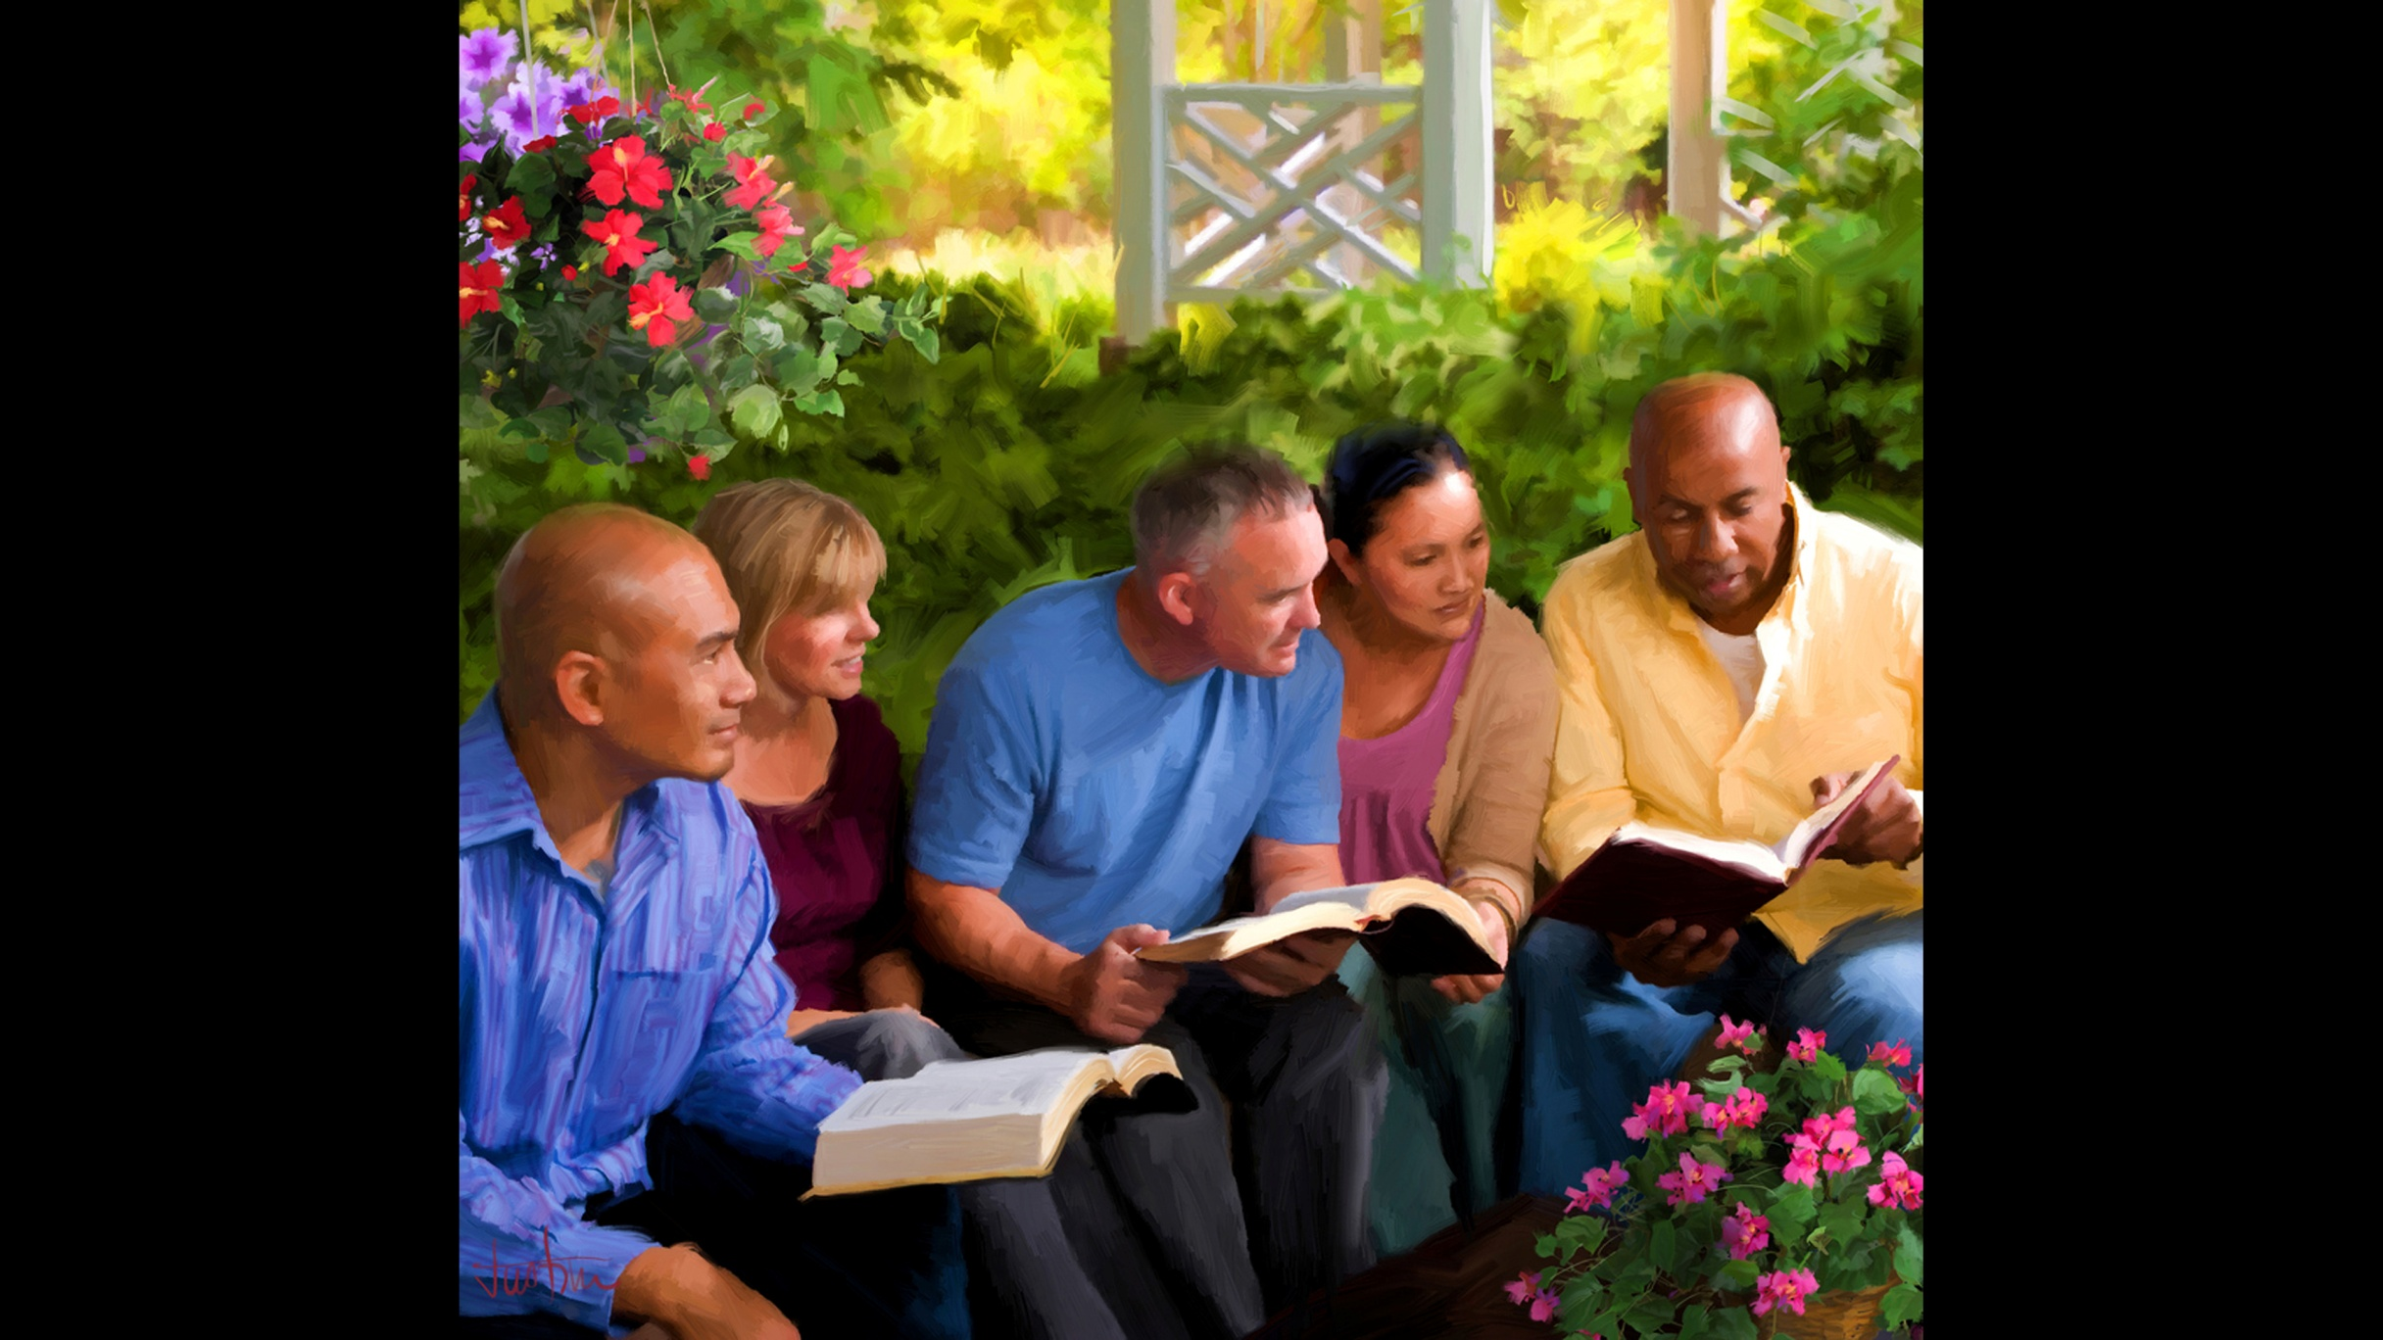
Next verse: John 17:17
Notes:
According to the Bible, we are purified by obeying the truth.
What is truth?

Slide 9
John 17:17
Sanctify them by Your word. Your word is _____.
Notes:
John 17:17
Sanctify them by Your word. Your word is truth.

Slide 10
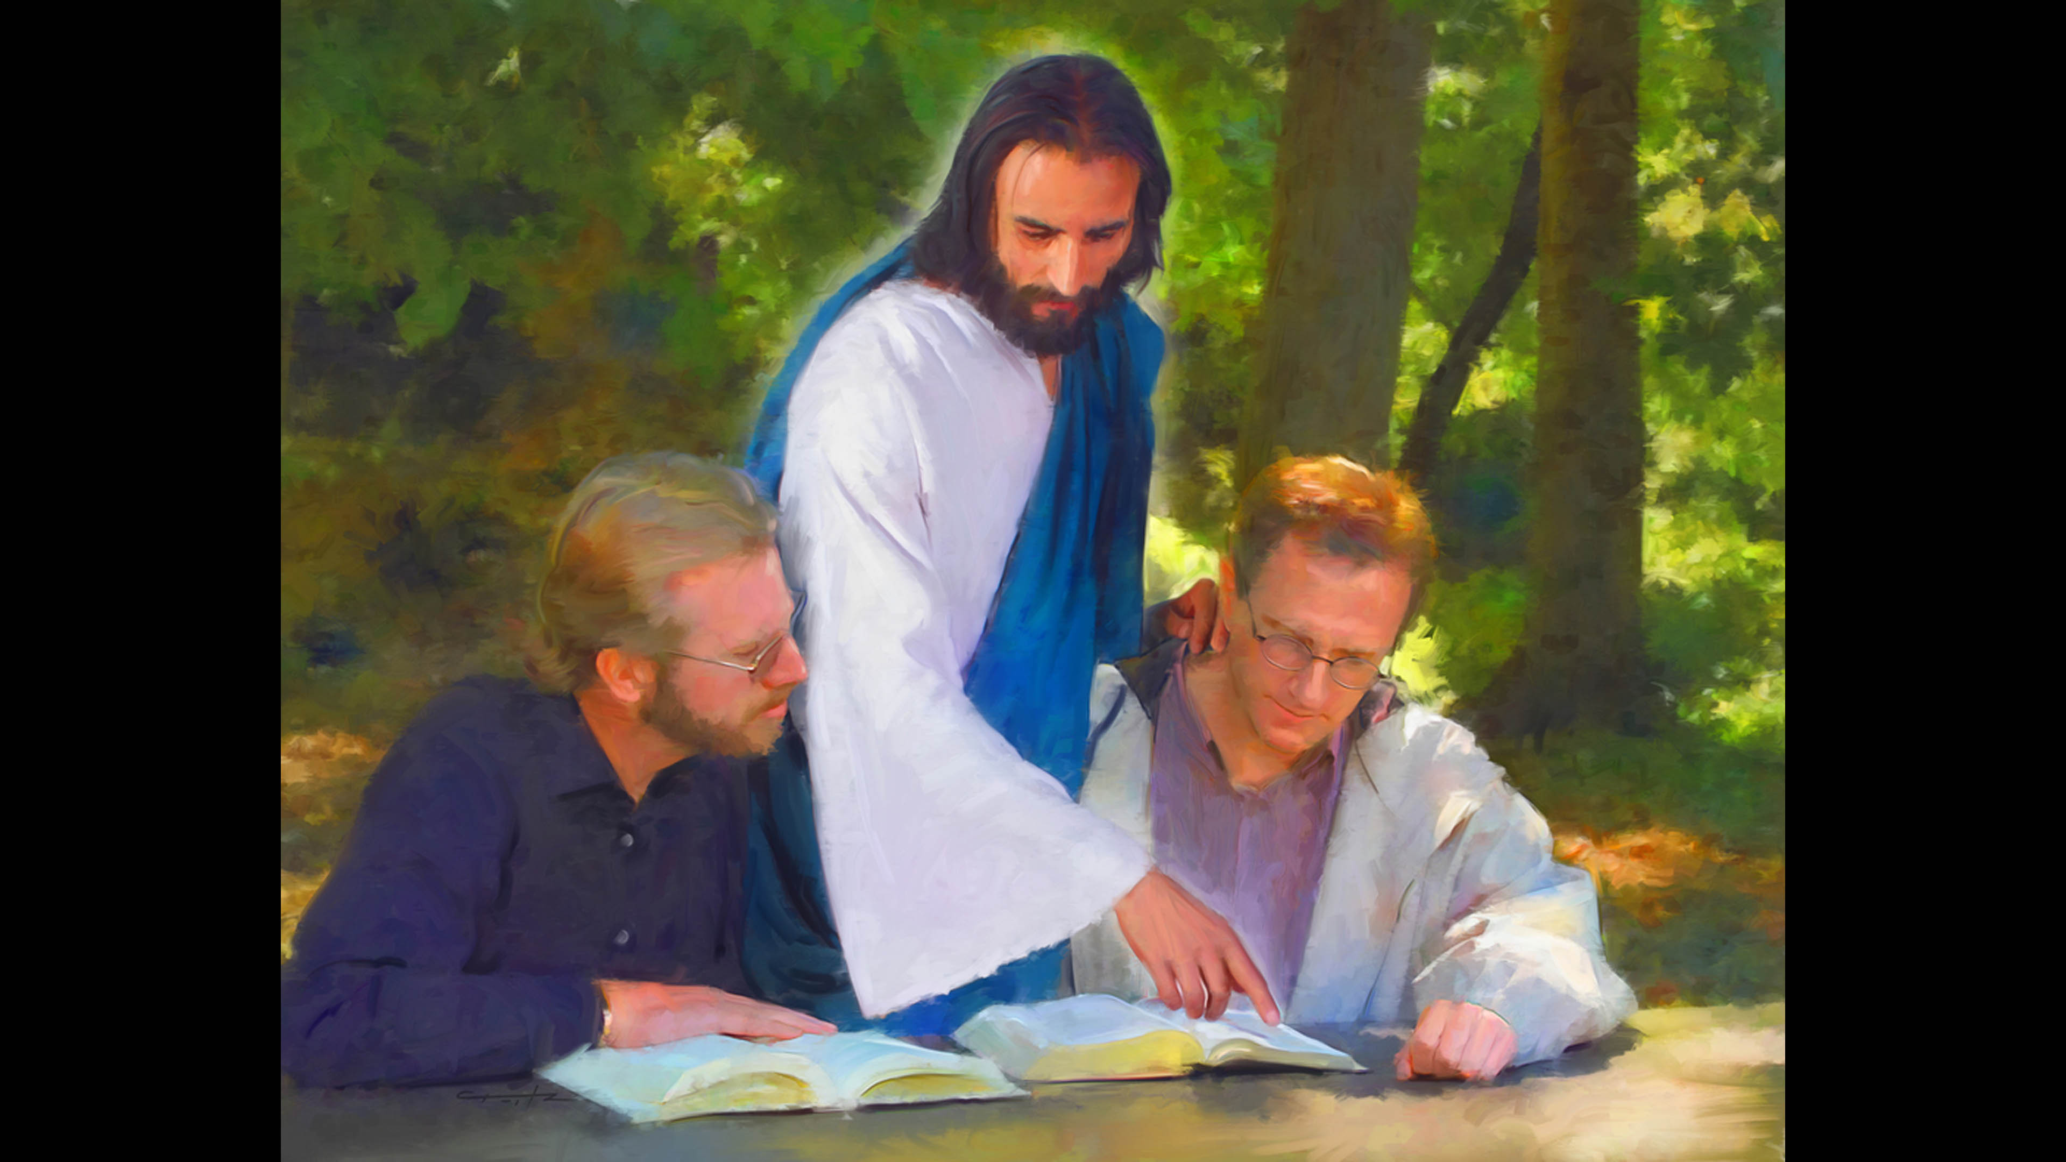
Next verse: Ephesians 5:25-27
Notes:
The Word of God is truth. As we prayerfully study and choose to obey it, God changes us. We are sanctified: made holy.
Why did Jesus give Himself for us?

Slide 11
Ephesians 5:25-27
...Christ also loved the church and gave Himself for her, (26) that He might ________ and cleanse her with the washing of water by the word, (27) that He might present her to Himself a glorious church, not having ____ or _______ or any such thing, but that she should be ____ and without blemish.
Notes:
Ephesians 5:25-27
...Christ also loved the church and gave Himself for her, (26) that He might sanctify and cleanse her with the washing of water by the word, (27) that He might present her to Himself a glorious church, not having spot or wrinkle or any such thing, but that she should be holy and without blemish.

Slide 12
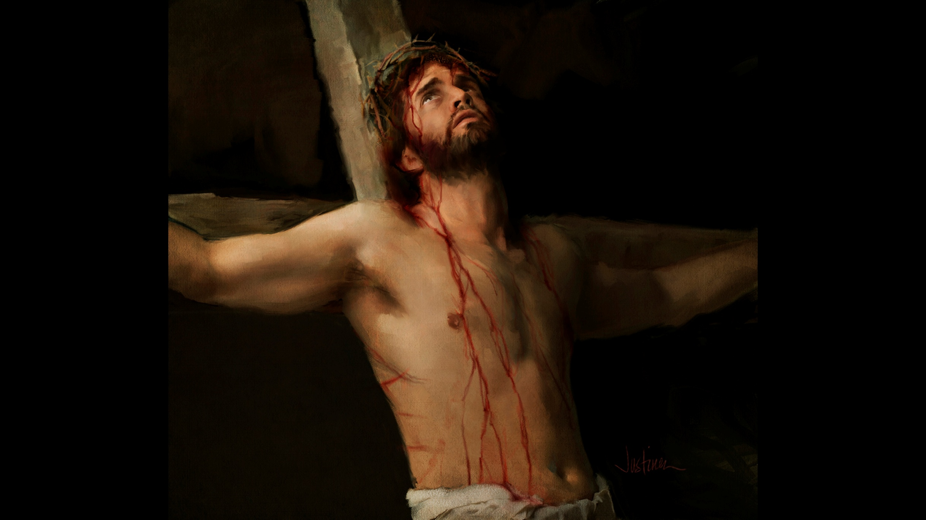
Next verse: Matthew 1:21
Notes:
Jesus gave Himself for us so that He could sanctify us, or make us holy, fit for fellowship with Him. He came to renew and re-create us in His own image.
Did He come to save us in our sins or from our sins?

Slide 13
Matthew 1:21
And she will bring forth a Son, and you shall call His name Jesus, for He will save His people ____ their sins.”
Notes:
Matthew 1:21
And she will bring forth a Son, and you shall call His name Jesus, for He will save His people from their sins.”

Slide 14
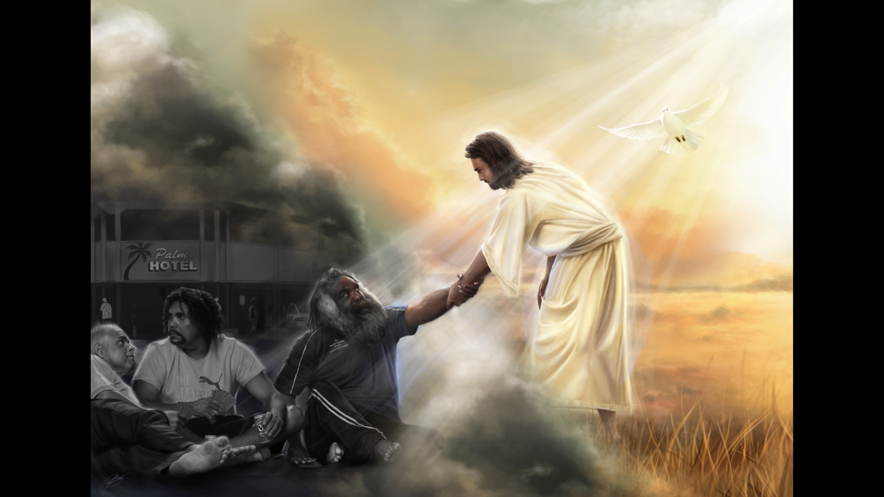
Next verse: 1 John 5:4; 2 Peter 1:4
Notes:
Jesus came not to save us in our sins, but FROM them. He came to give us victory over sin, over Satan, and over the world.
How do we get this victory?

Slide 15
1 John 5:4
For whatever is born of God overcomes the world. And this is the victory that has overcome the world—our _____.
2 Peter 1:4
by which have been given to us exceedingly great and precious ________, that through these you may be partakers of the divine ______, having escaped the corruption that is in the world through lust.
Notes:
1 John 5:4
For whatever is born of God overcomes the world. And this is the victory that has overcome the world—our faith.
2 Peter 1:4
by which have been given to us exceedingly great and precious promises, that through these you may be partakers of the divine nature, having escaped the corruption that is in the world through lust.

Slide 16
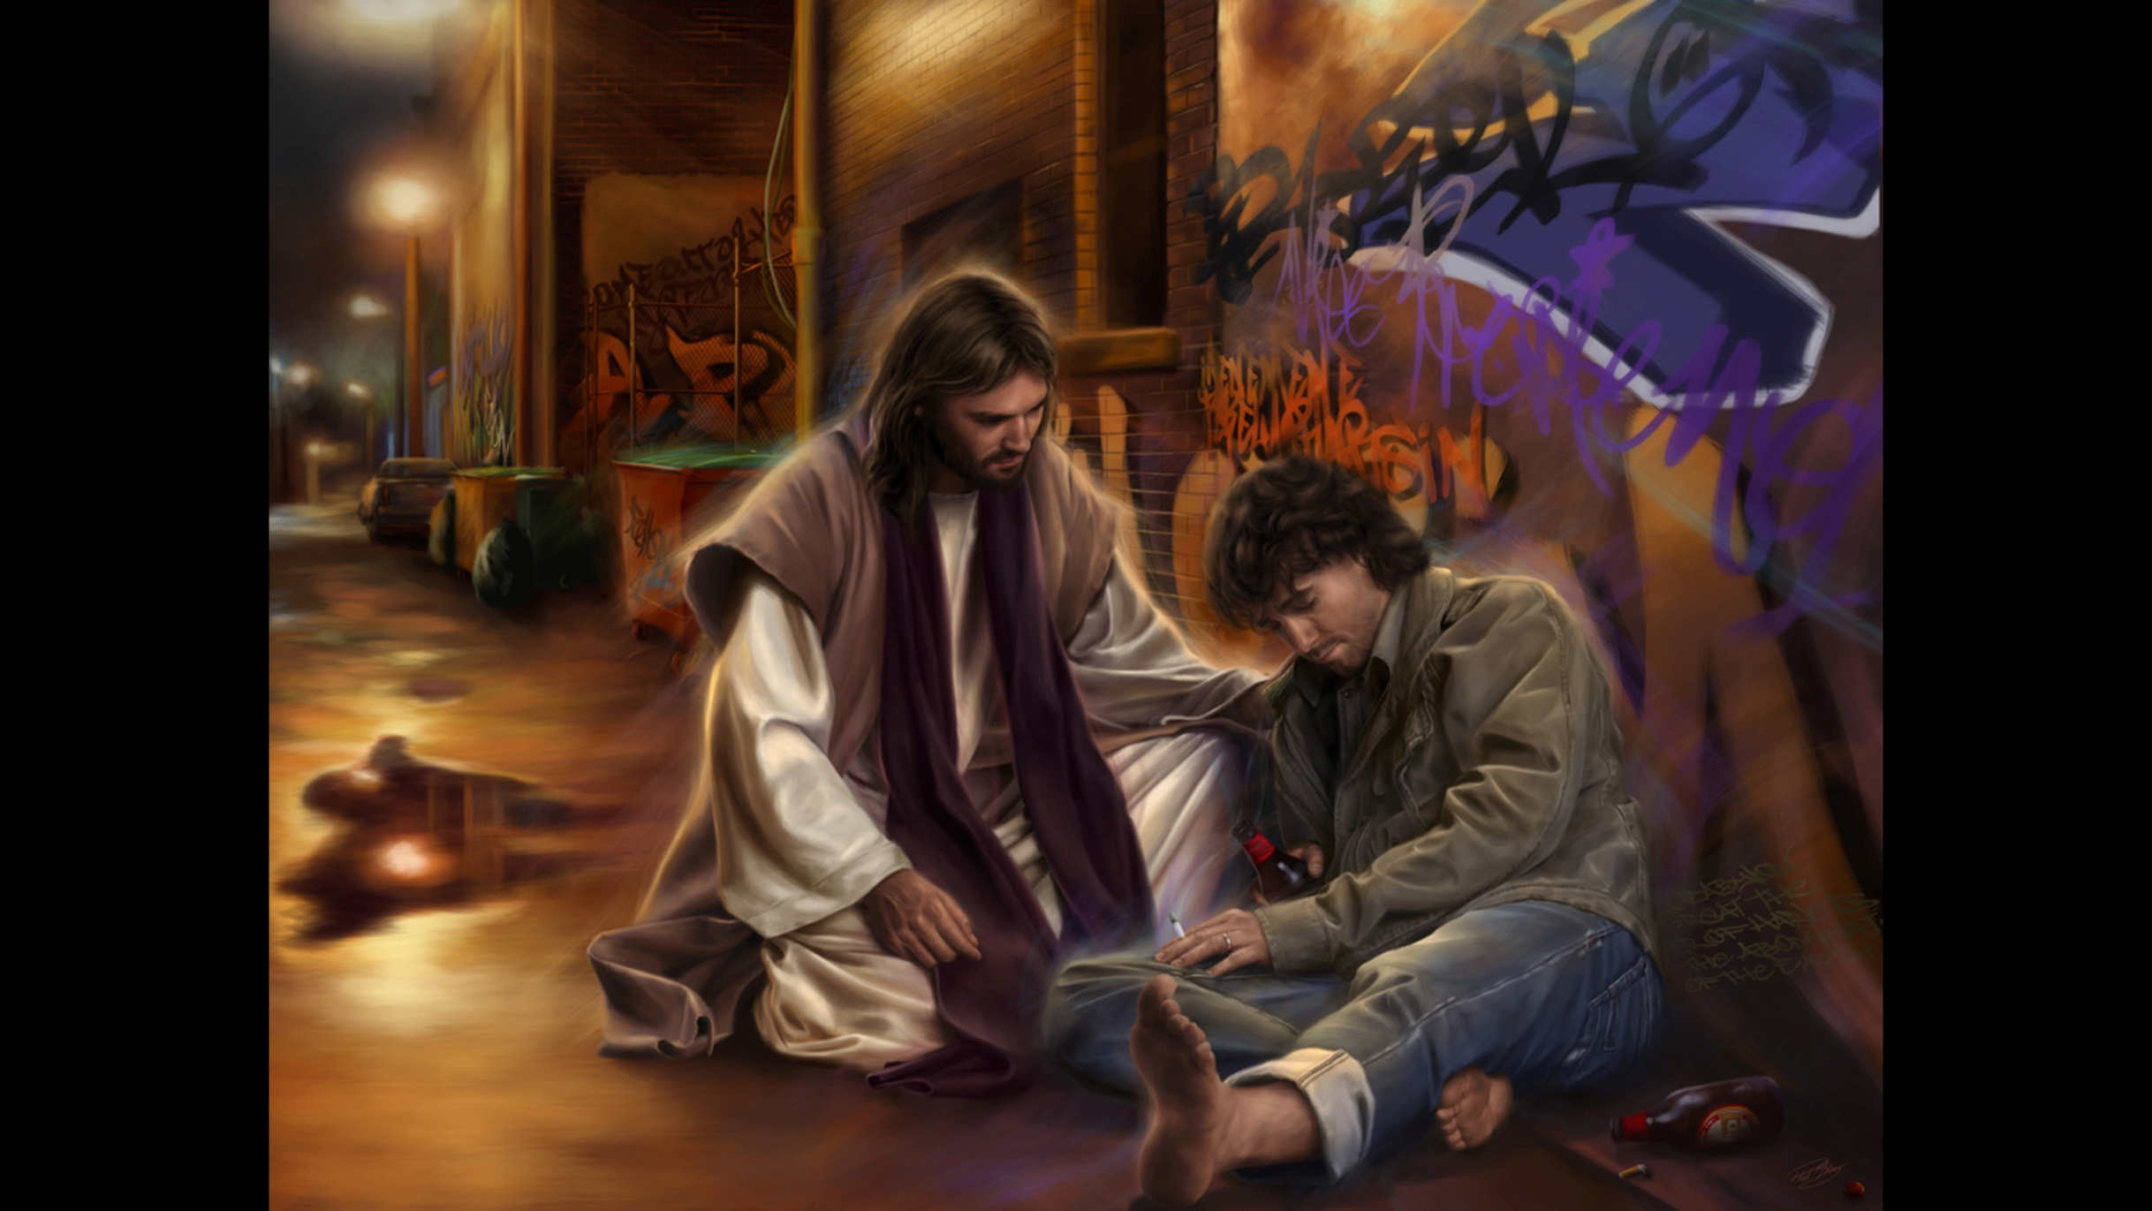
Next verse: Hebrews 10:16; 1 Corinthians 7:1
Notes:
Through faith we grasp God’s promises, claiming the power of God to change our sinful nature and desires. The same power that raised Jesus from the dead works in us, so that we can “walk in newness of life”. ¹
What has God promised to put in our minds?

Slide 17
Hebrews 10:16
“This is the covenant that I will make with them after those days, says the Lord: I will put My ____ into their ______, and in their _____ I will write them,”
2 Corinthians 7:1
Therefore, having these promises, beloved, let us _______ ourselves from all filthiness of the flesh and spirit, perfecting ________ in the fear of God.
Notes:
Hebrews 10:16
“This is the covenant that I will make with them after those days, says the Lord: I will put My laws into their hearts, and in their minds I will write them,”
2 Corinthians 7:1
Therefore, having these promises, beloved, let us cleanse ourselves from all filthiness of the flesh and spirit, perfecting holiness in the fear of God.

Slide 18
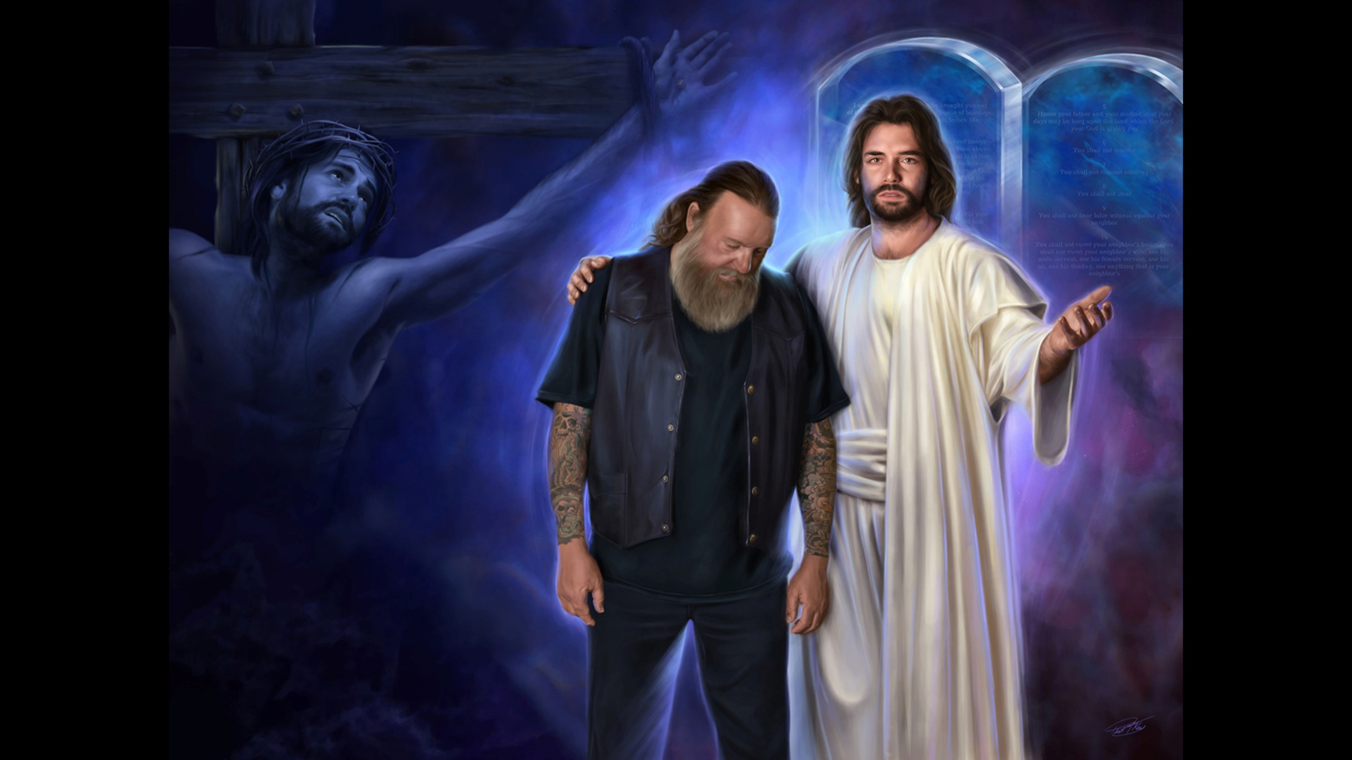
Next verse: Ezekiel 9:4-6
Notes:
When God writes His law on our hearts and minds, it changes us. Our desires are different. We WANT to obey God. We find JOY in pleasing Him. Sin becomes more and more disgusting to us.
God’s followers will not try to excuse sin. It pains them to see God dishonored. The torrent of prevailing wickedness fills them with grief and alarm. They can’t remain silent when confronted with evil.
God knows each of these faithful ones.
What does this have to do with the sealing?

Slide 19
Ezekiel 9:4-6
And the Lord said to him, “Go through the midst of the city through the midst of Jerusalem, and put a ____ on the _________ of the men who sigh and cry over all the abominations that are done within it.” (5) To the others He said in my hearing, “Go after him through the city and kill; do not let your eye spare, nor have any pity.
(6) Utterly slay old and young men, maidens and little children and women; but do not come near anyone on whom is the mark; and begin at My sanctuary. So they began with the elders who were before the temple.
Notes:
Ezekiel 9:4-6
And the Lord said to him, “Go through the midst of the city through the midst of Jerusalem, and put a mark on the foreheads of the men who sigh and cry over all the abominations that are done within it.” (5) To the others He said in my hearing, “Go after him through the city and kill; do not let your eye spare, nor have any pity. (6) Utterly slay old and young men, maidens and little children and women; but do not come near anyone on whom is the mark; and begin at My sanctuary. So they began with the elders who were before the temple.

Slide 20
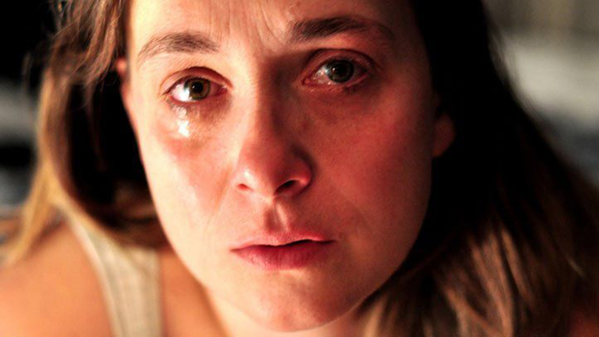
Next verse:
Ecclesiastes 8:11
Revelation 2:5
Notes:
Those who mourn over their own sins and the sins of others, who are not indifferent to the pain sin causes, are the ones who are marked by God. Their love for others leads them to warn and reprove those who do not believe—those who think God is too merciful to bring judgment on the disobedient.
In this vision of Ezekiel, the church was the first to feel God’s wrath. The ones who should have been spiritual guardians had betrayed their trust.
Will sin be punished by God?

Slide 21
Ecclesiastes 8:11
Because the sentence against an evil work is not ________ speedily, therefore the heart of the sons of men is fully set in them to do ____.
Revelation 2:5
“Remember therefore from where you have fallen: repent and do the first works, or else I will come to you quickly and remove your lampstand from its place–unless you ______.”
Next verse: Revelation 6:17; Psalm 34:15,16
Notes:
Ecclesiastes 8:11
Because the sentence against an evil work is not executed speedily, therefore the heart of the sons of men is fully set in them to do evil.
Revelation 2:5
“Remember therefore from where you have fallen: repent and do the first works, or else I will come to you quickly and remove your lampstand from its place—unless you repent.”

Slide 22
Revelation 6:17
“For the great day of His _____ is come, and who is able to stand?”
Psalm 34:15,16
The eyes of the Lord are on the righteous, and His ears are open to their cry. (16) The face of the Lord is against those who do ____, to cut off the remembrance of them from the _____.
Notes:
Revelation 6:17
“For the great day of His wrath is come, and who is able to stand?”
Psalm 34:15,16
The eyes of the Lord are on the righteous, and His ears are open to their cry. (16) The face of the Lord is against those who do evil, to cut off the remembrance of them from the earth.

Slide 23
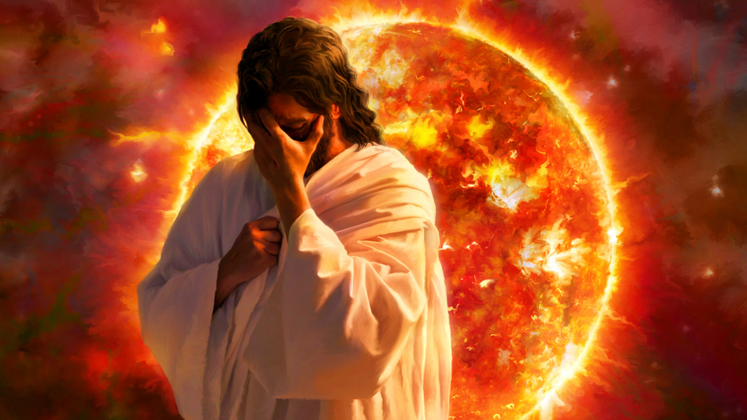
Next verse: Exodus 12:23
Notes:
Jesus’ work in the Heavenly Sanctuary is almost finished. Soon the wrath of God and the seven last plagues will be poured out on those who have exceeded the limits of grace and mercy and have not responded to the warnings and light God has given them. The patience and longsuffering of God has only hardened them in their sinful course. Soon there will be no more pleading of mercy. Their accounts will be closed. They will have no protection from the wrath of God against evil.
How were the Israelites marked for protection when the plagues fell on Egypt?

Slide 24
Exodus 12:23
For the Lord will pass through to strike the Egyptians: and when He sees the _____ on the lintel and on the two doorposts, the Lord will ____ ____ the door and not allow the destroyer to come into your house to strike you.
Notes:
Exodus 12:23
For the Lord will pass through to strike the Egyptians: and when He sees the blood on the lintel and on the two doorposts, the Lord will pass over the door and not allow the destroyer to come into your house to strike you.

Slide 25
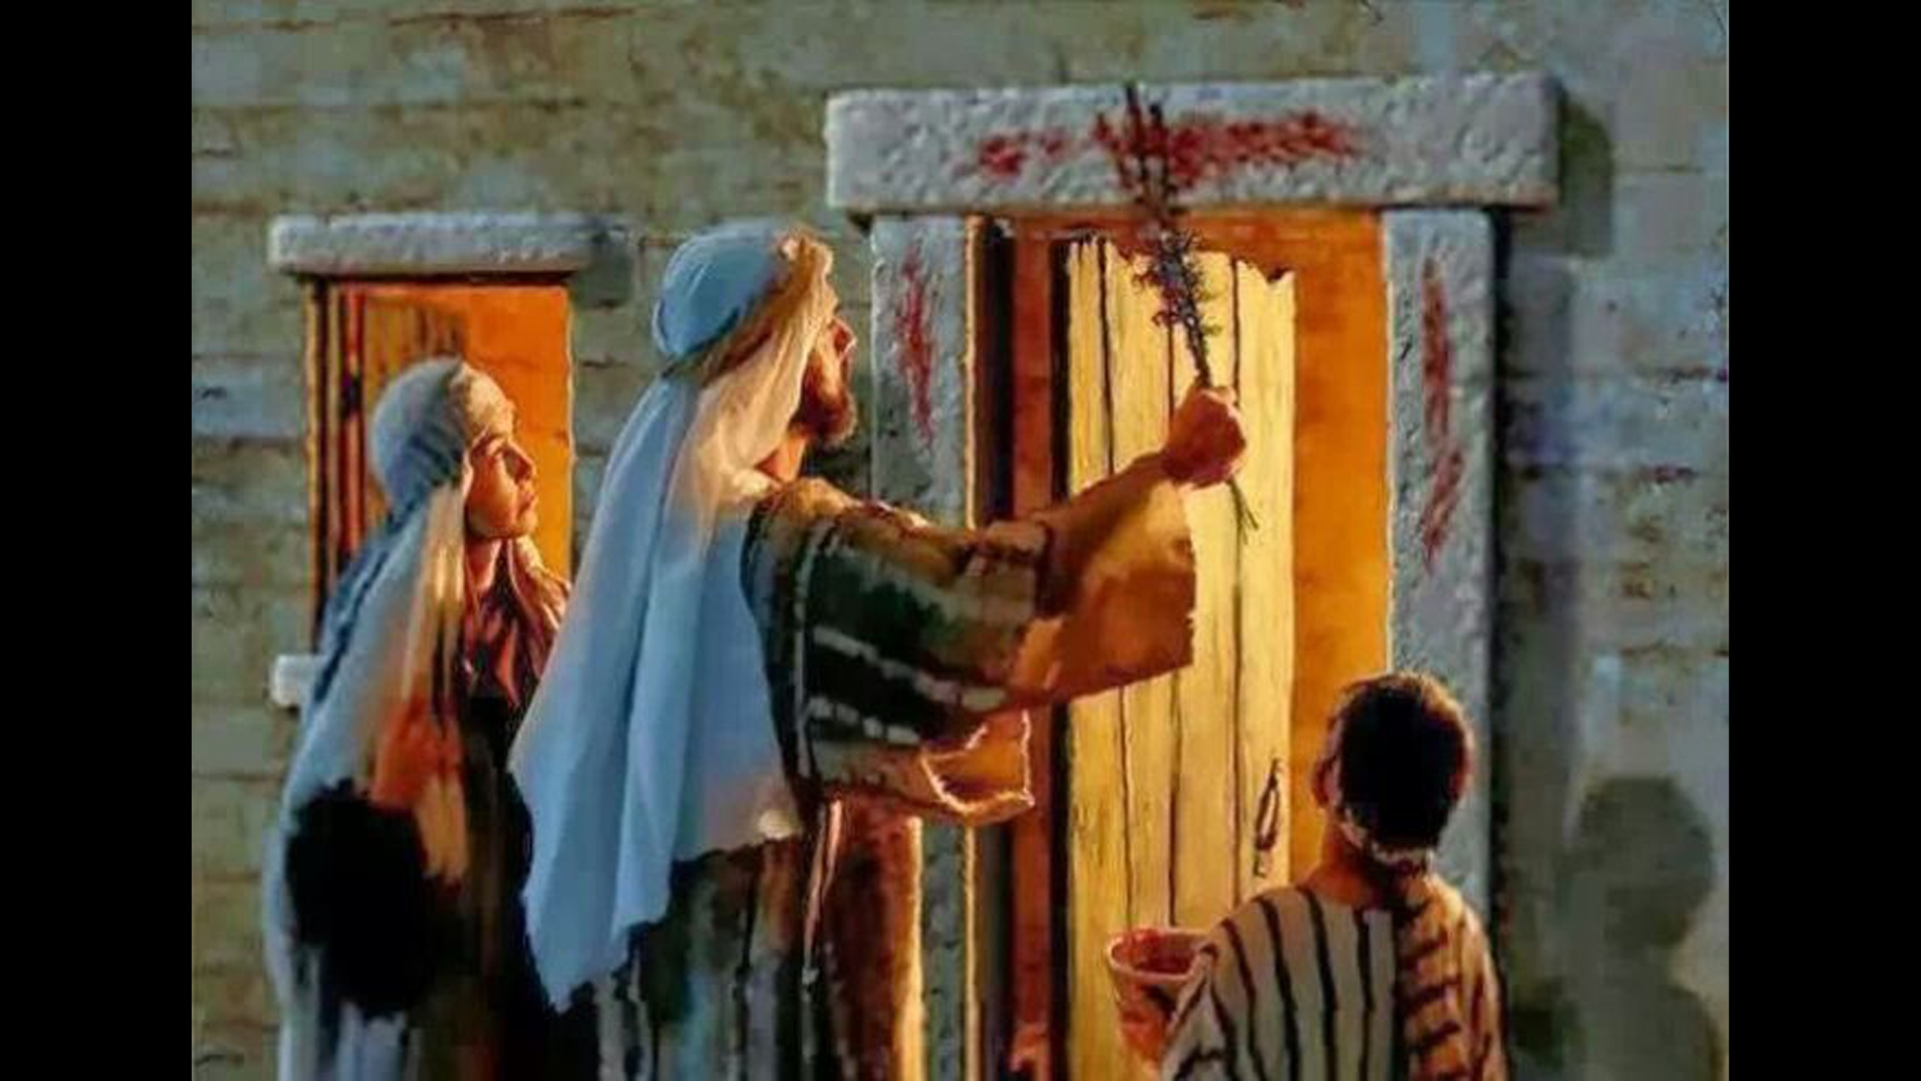
Notes:
They were saved by the blood. The destroying angel passed over every house that was marked in this way. If they neglected to carry out the instructions completely—if they prepared the Passover lamb but didn’t separate their children from the Egyptians, gather within their own dwellings, mark the doorposts with blood, stay inside their home that night—they would not have been secure. They might have believed they had done everything right, but sincerity was not enough to save them.

Slide 26
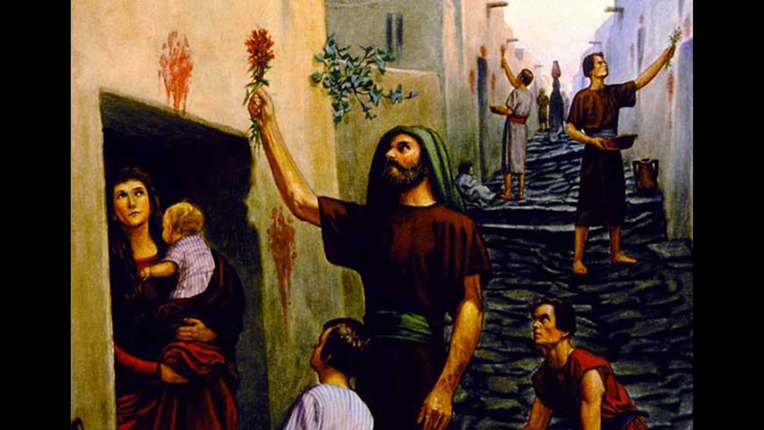
Next verse: John 14:15; 1 John 2:4; Ezekiel 22:8
Notes:
In the same way, we are saved by faith, not by works; yet our faith is demonstrated by our works. Like the Israelites, we must believe and obey God’s requirements for our salvation.
Will God’s end-time followers show their allegiance to Him by keeping His ten commandments?

Slide 27
John 14:15
If you love Me, ____ My ____________.
1 John 2:4
He who says, “I know Him,” and does not ____ His commandments, is a ____ and the truth is not in him.
Ezekiel 22:8
You have despised My holy things and profaned My ________.
Next verse: Revelation 14:12; 22:14
Notes:
John 14:15
If you love Me, keep My commandments.
1 John 2:4
He who says, “I know Him,” and does not keep His commandments, is a liar and the truth is not in him.
Ezekiel 22:8
You have despised My holy things and profaned My Sabbaths.

Slide 28
Revelation 14:12
Here is the patience of the saints; here are those who ____ the ____________ of God and the faith of Jesus.
Revelation 22:14
Blessed are those who do His ____________, that they may have the right to the tree of life, and may enter through the gates into the city.
Notes:
Revelation 14:12
Here is the patience of the saints; here are those who keep the commandments of God and the faith of Jesus.
Revelation 22:14
Blessed are those who do His commandments, that they may have the right to the tree of life, and may enter through the gates into the city.

Slide 29
Next verse: Exodus 20:8-11
Notes:
There are two marks of allegiance in the last days—the mark of the beast and the Seal of God. Those who receive the Seal of God have rejected the mark of the beast, the false sabbath. They are commandment keepers, keeping— through the power of God—all the commandments, including the fourth.
What is the fourth commandment?

Slide 30
Exodus 20:8-11
“Remember the Sabbath day, to keep it holy. (9) Six days you shall labor and do all your work, (10) but the seventh day is the Sabbath of the Lord your God. In it, you shall do no work: you, nor your son, nor your daughter, nor your male servant, nor your female servant, nor your cattle, nor your stranger who is within your gates. (11) For in six days the Lord made the heavens and the earth, the sea, and all that is in them, and rested the seventh day. Therefore the Lord blessed the Sabbath day and hallowed it.
Notes:
Genesis 2:1-3
Thus the heavens and the earth, and all the host of them, were finished. (2) And on the seventh day God ended His work which He had done, and He rested on the seventh day from all His work which He had done. (3) Then God blessed the seventh day and sanctified it, because in it He rested from all His work which God had created and made.

Slide 31
Next verse:
Ezekiel 20:12
Exodus 31:16,17
Notes:
The fourth commandment is the seal, or mark, of God’s authority. It contains the essential elements of an official seal: His name—the Lord; His title—Maker, Creator; and His kingdom—Heaven and Earth. The fourth commandment is the only one that identifies God as the Creator, proving all rivals to be false gods!
God’s true followers show their allegiance to Him by keeping holy the seventh day, the Sabbath He sanctified and blessed.
What is the Sabbath a sign of?

Slide 32
Ezekiel 20:12
Moreover I also gave them My Sabbaths, to be a sign between them and Me, that they might know that I am the Lord who _________ them.
Exodus 31:16,17
Therefore the children of Israel shall keep the Sabbath, to observe the Sabbath throughout their generations as a perpetual ________. (17) It is a sign between Me and the children of Israel forever; for in six days the Lord ____ the heavens and the earth, and on the seventh day He ______ and was refreshed.’ ”
Notes:
Ezekiel 20:12
Moreover I also gave them My Sabbaths, to be a sign between them and Me, that they might know that I am the Lord who sanctifies them.
Exodus 31:16,17
Therefore the children of Israel shall keep the Sabbath, to observe the Sabbath throughout their generations as a perpetual covenant. (17) It is a sign between Me and the children of Israel forever; for in six days the Lord made the heavens and the earth, and on the seventh day He rested and was refreshed.’ ”

Slide 33
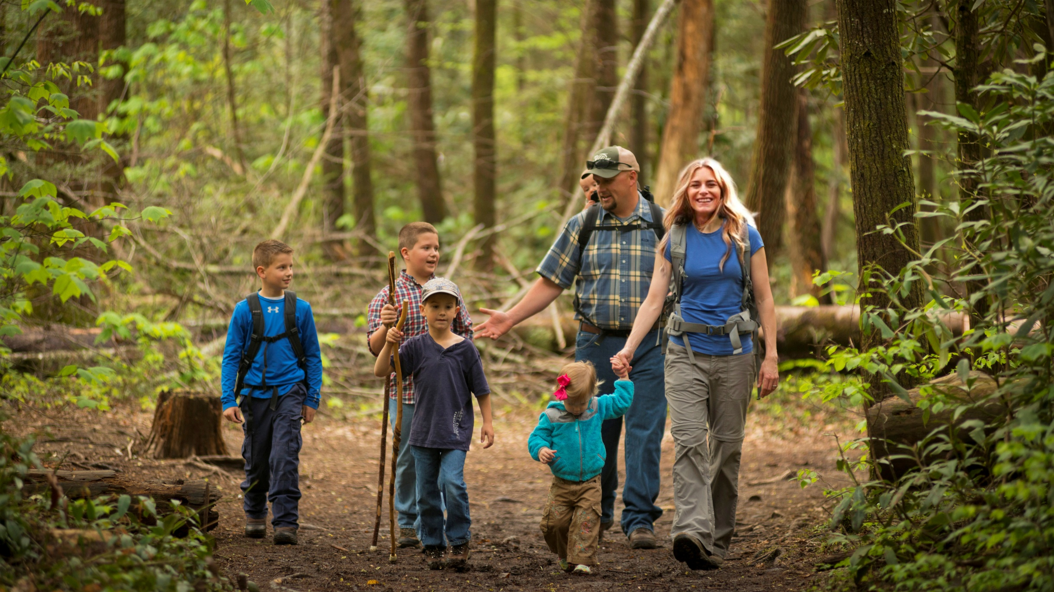
Next verse: Psalm 19:7; 40:8; 119:97,126,127
Notes:
Resting on the Sabbath is how we worship our Lord, the Creator of Heaven and Earth. It shows that we believe He is not only able, but in the process of, re-creating us—sanctifying us, making us holy, fit for heaven. It shows that we do not trust in our own works, but in His work, both on the cross and in our hearts. It is a sign of allegiance to God and His law. As disrespect for God’s law becomes more prevalent, those who serve God will stand out as distinct from the world.
How did David feel about God’s law?

Slide 34
Psalm 19:7; 40:8; 119:97,126,127
(19:7) The law of the Lord is _______, converting the soul; the testimony of the Lord is sure, making wise the simple;
(40:8) I _______ to do Your will, O my God, and Your law is within my heart.
(119:97) Oh, how I ____ Your law! It is my meditation all the day.
(119:126,127) It is time for You to act, O Lord, for they have regarded Your law as ____. Therefore I love Your commandments more than ____, yes, than fine gold!
Notes:
Psalm 19:7; 40:8; 119:97,126,127
(19:7) The law of the Lord is perfect, converting the soul; the testimony of the Lord is sure, making wise the simple;
(40:8) I delight to do Your will, O my God, and Your law is within my heart.
(119:97) Oh, how I love Your law! It is my meditation all the day.
(119:126,127) It is time for You to act, O Lord, for they have regarded Your law as void. Therefore I love Your commandments more than gold, yes, than fine gold!

Slide 35
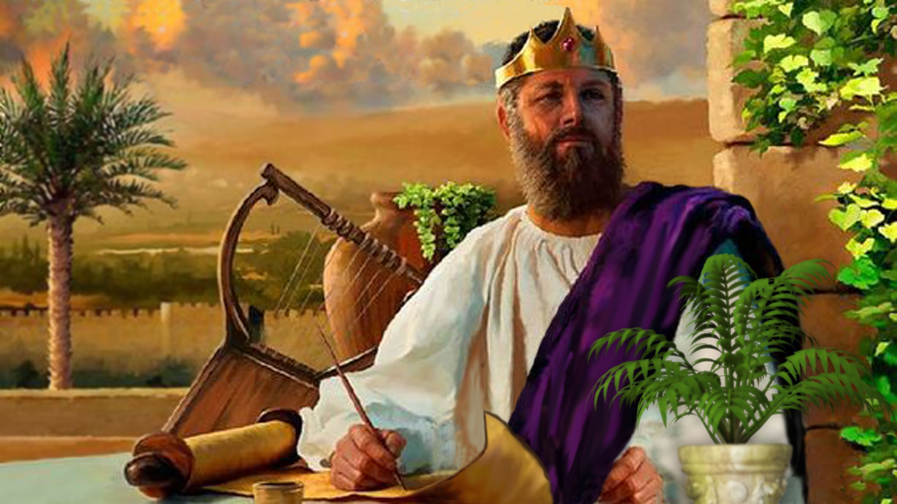
Next verse: Exodus 19:5; Malachi 3:17
Notes:
David loved the law of God. When he saw it maligned, he looked for God to show His righteous displeasure. Today, when the earth is full of crime and violence, God needs those who, like David, will exalt His law and demonstrate loyalty to Him. These are the ones who will receive the seal of God.
What does God think of them?

Slide 36
Exodus 19:5
Now therefore, if you will indeed obey My voice and keep My covenant, then you shall be a special ________ to Me above all people; for all the earth is Mine.
Malachi 3:17
“They shall be ____,” says the Lord of hosts, “on the day that I make them My______. And I will spare them as a man spares his own son who serves Him.”
Notes:
Exodus 19:5
Now therefore, if you will indeed obey My voice and keep My covenant, then you shall be a special treasure to Me above all people; for all the earth is Mine.
Malachi 3:17
“They shall be Mine,” says the Lord of hosts, “on the day that I make them My jewels. And I will spare them as a man spares his own son who serves Him.”

Slide 37
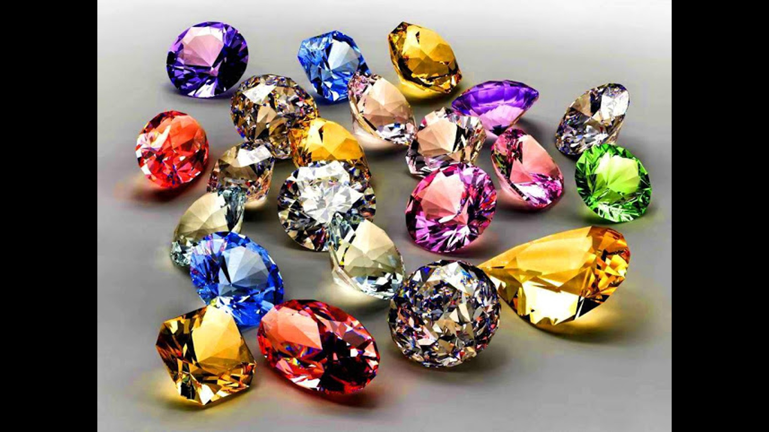
Next verse: 1 Corinthians 4:9; 1 Peter 2:9
Notes:
Not only are we of incredible value to God, He wants to show us off to the universe!
What do our lives display about God?

Slide 38
1 Corinthians 4:9
...we have been made a _________ to the world, both to angels and to men.
1 Peter 2:9
But you are a ______ generation, a _____ priesthood, a ____ nation, His own _______ people, that you may proclaim the praises of Him who called you out of darkness into His marvelous light.
Notes:
1 Corinthians 4:9
...we have been made a spectacle to the world, both to angels and to men.
1 Peter 2:9
But you are a chosen generation, a royal priesthood, a holy nation, His own special people, that you may proclaim the praises of Him who called you out of darkness into His marvelous light.

Slide 39
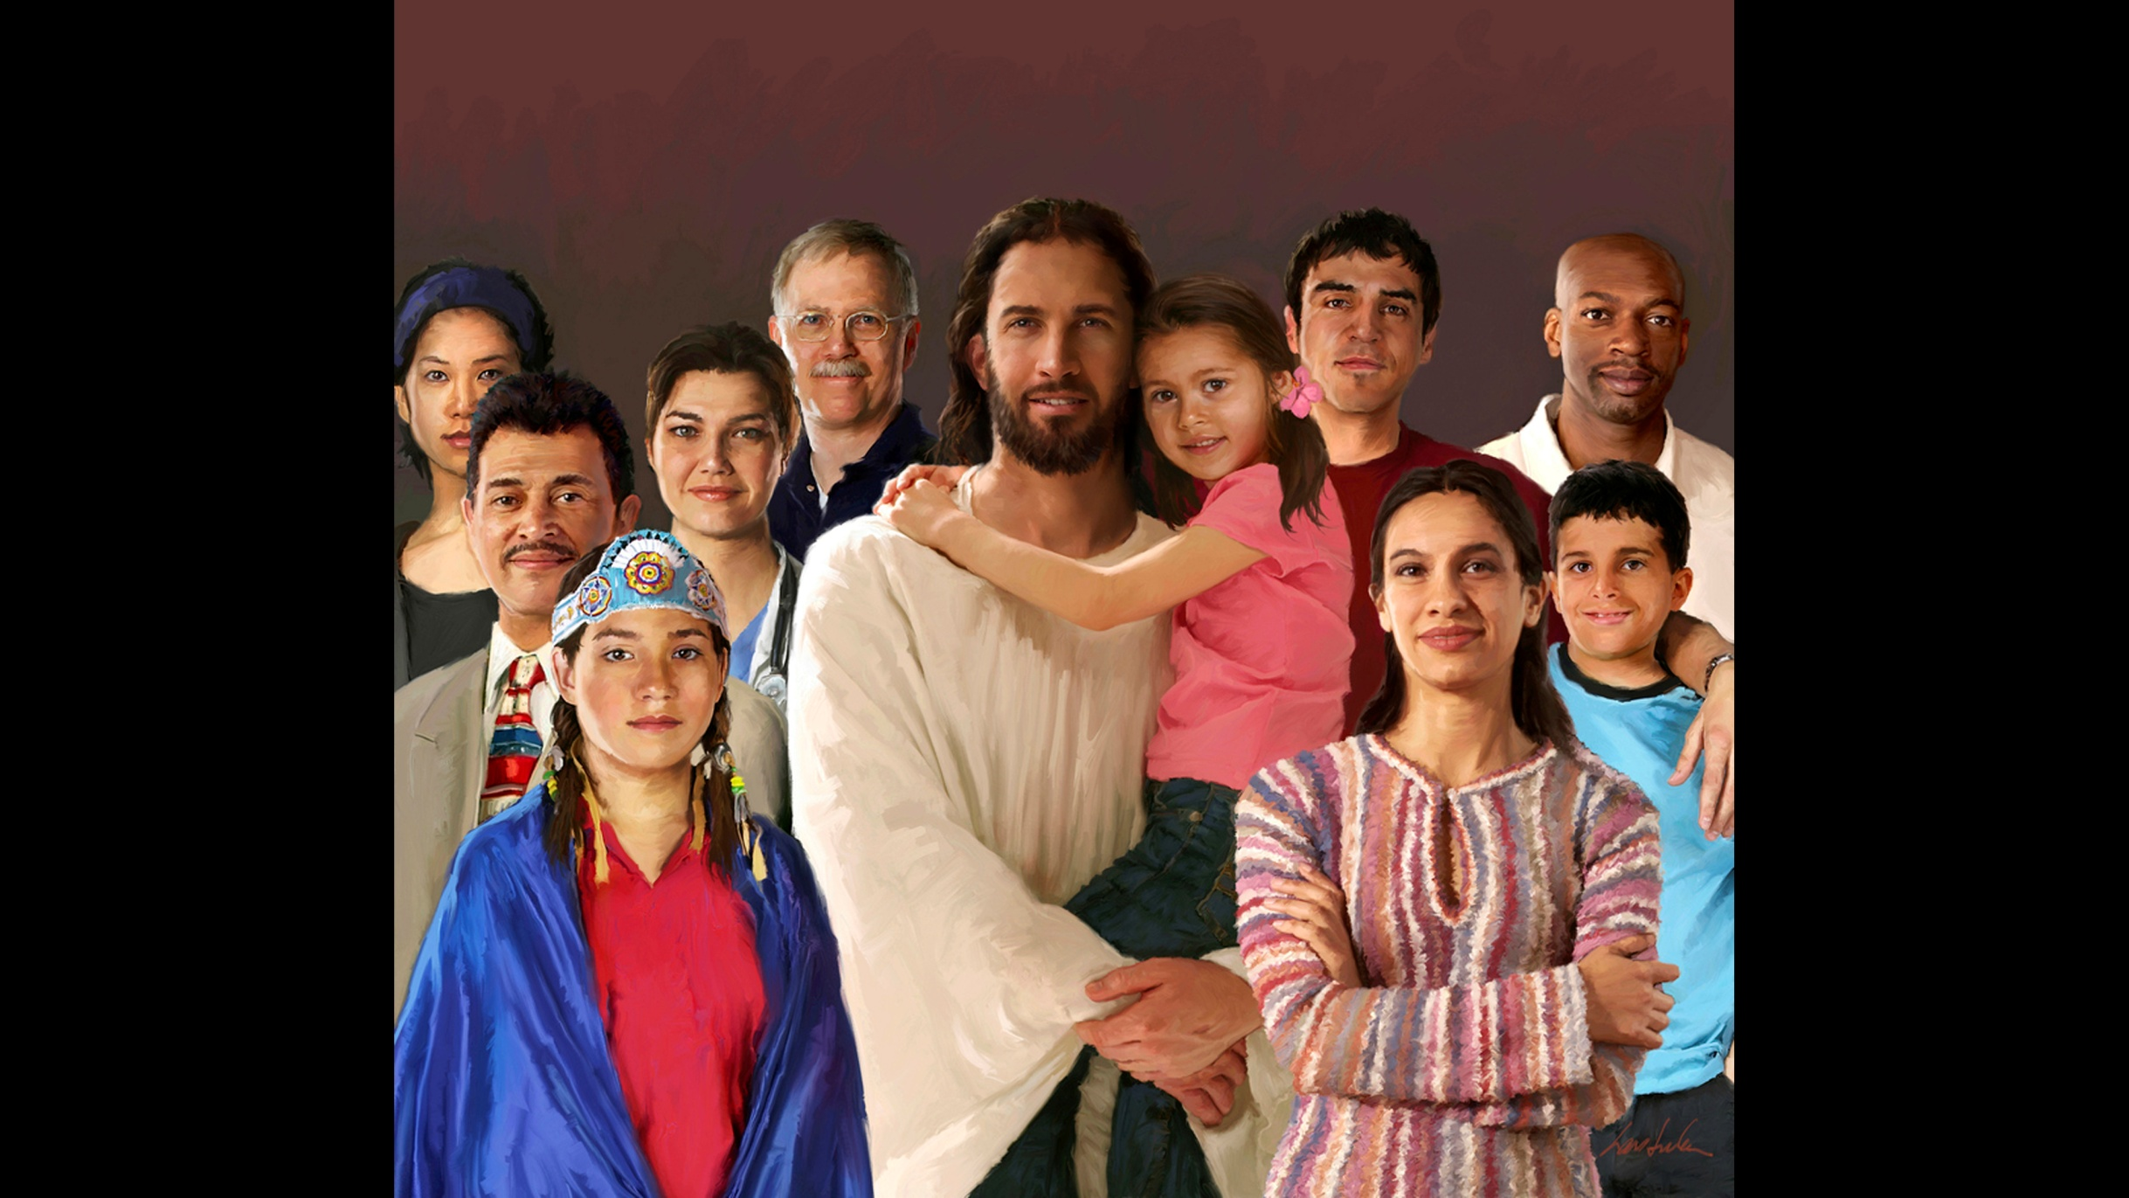
Next verse: Isaiah 8:16; 58:12,13
Notes:
This faithful, loyal group of people is God’s special treasure that He holds in a revolted world! Though them the whole universe witnesses the power of His grace and love.
What is their special work?

Slide 40
Isaiah 8:16
Bind up the testimony, seal the ___ among My disciples.
Isaiah 58:12,13
...you shall be called the Repairer of the ______...if you...call the _______ a delight, the holy day of the Lord...
Notes:
Isaiah 8:16
Bind up the testimony, seal the law among My disciples.
Isaiah 58:12,13
...you shall be called the Repairer of the breach...if you...call the Sabbath a delight, the holy day of the Lord...

Slide 41
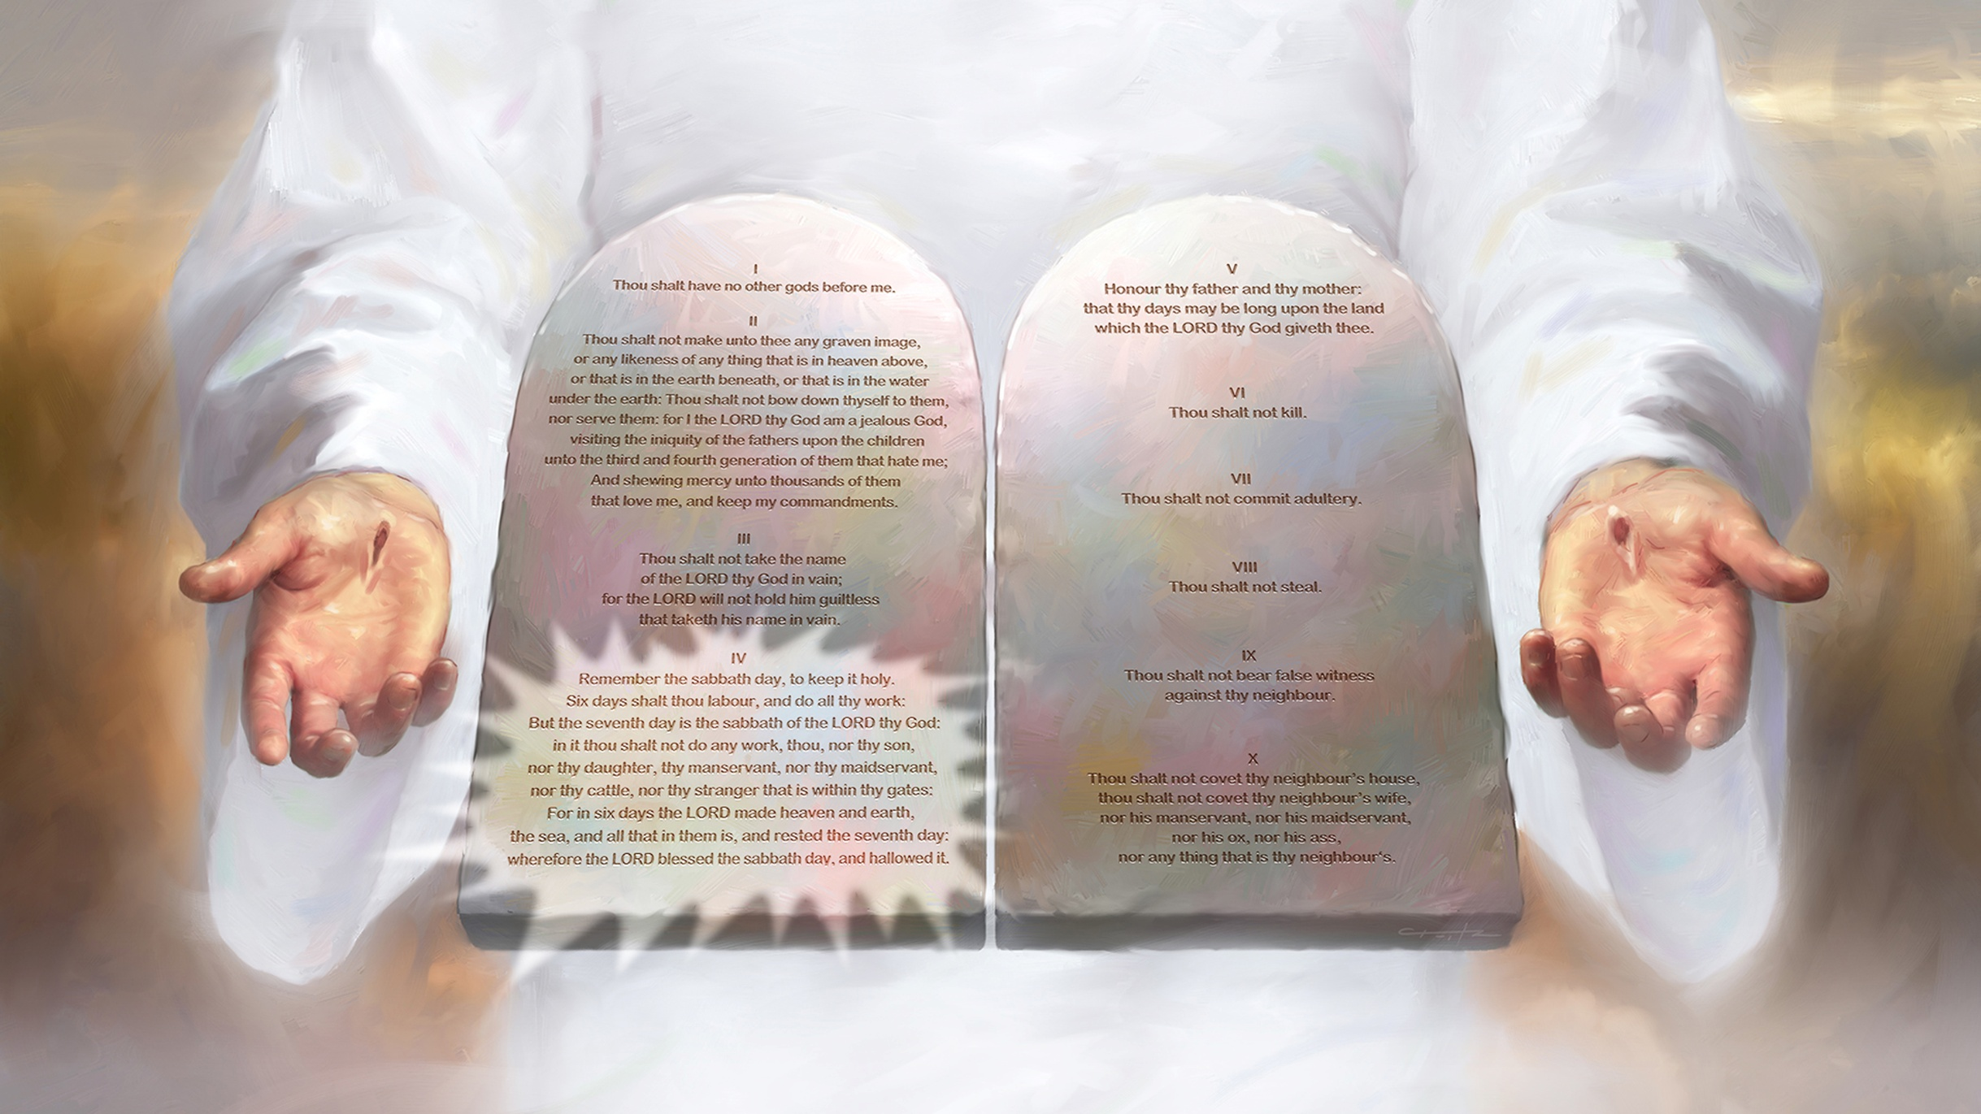
Next verse: Ephesians 1:13; Acts 5:32
Notes:
When the Sabbath was changed by the papal power, the seal was taken from the law. (see study on How to Avoid the Mark of the Beast ). God’s people are called to restore the seal by elevating the Sabbath of the fourth commandment to its rightful position, as the Creator’s memorial and sign of His authority. The breach made in the law of God is to be repaired.
What part does the Holy Spirit have in the sealing?

Slide 42
Ephesians 1:13
In Him you also trusted, after you heard the word of truth, the gospel of your salvation; in whom also, having believed, you were ______ with the Holy Spirit of promise,
Acts 5:32
And we are His witnesses to these things, and so is the Holy Spirit, whom God has given to those who ____ Him.
Notes:
Ephesians 1:13
In Him you also trusted, after you heard the word of truth, the gospel of your salvation; in whom also, having believed, you were sealed with the Holy Spirit of promise,
Acts 5:32
And we are His witnesses to these things, and so is the Holy Spirit, whom God has given to those who obey Him.

Slide 43
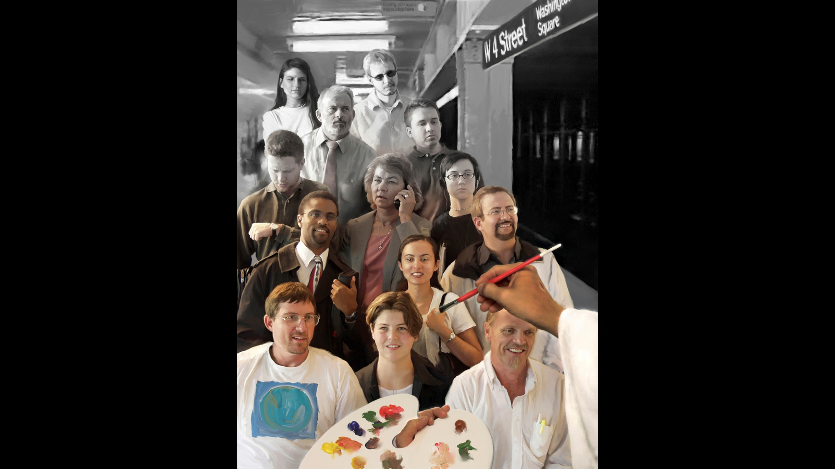
Next verse:
Psalm 27:3,4
1 Peter 1:16
Matthew 5:48
Notes:
Through the power of the Holy Spirit, God is making transformations on human hearts so amazing that the angels watch in astonishment and joy. Satan is baffled and enraged as he sees people set free from his deceptions and traps. These people are preparing for the seal of God and for “the marriage supper of the Lamb”.
How have their characters changed?

Slide 44
Psalm 27:3,4
Who may ascend into the hill of the Lord? Or who may stand in His holy place? (4) He who has _____ hands and a ____ heart…
1 Peter 1:16
...“Be ____, for I am holy.”
Matthew 5:48
“Therefore you shall be _______, just as your Father in heaven in perfect.”
Notes:
Psalm 27:3,4
Who may ascend into the hill of the Lord? Or who may stand in His holy place? (4) He who has clean hands and a pure heart…
1 Peter 1:16
...“Be holy, for I am holy.”
Matthew 5:48
“Therefore you shall be perfect, just as your Father in heaven in perfect.”

Slide 45
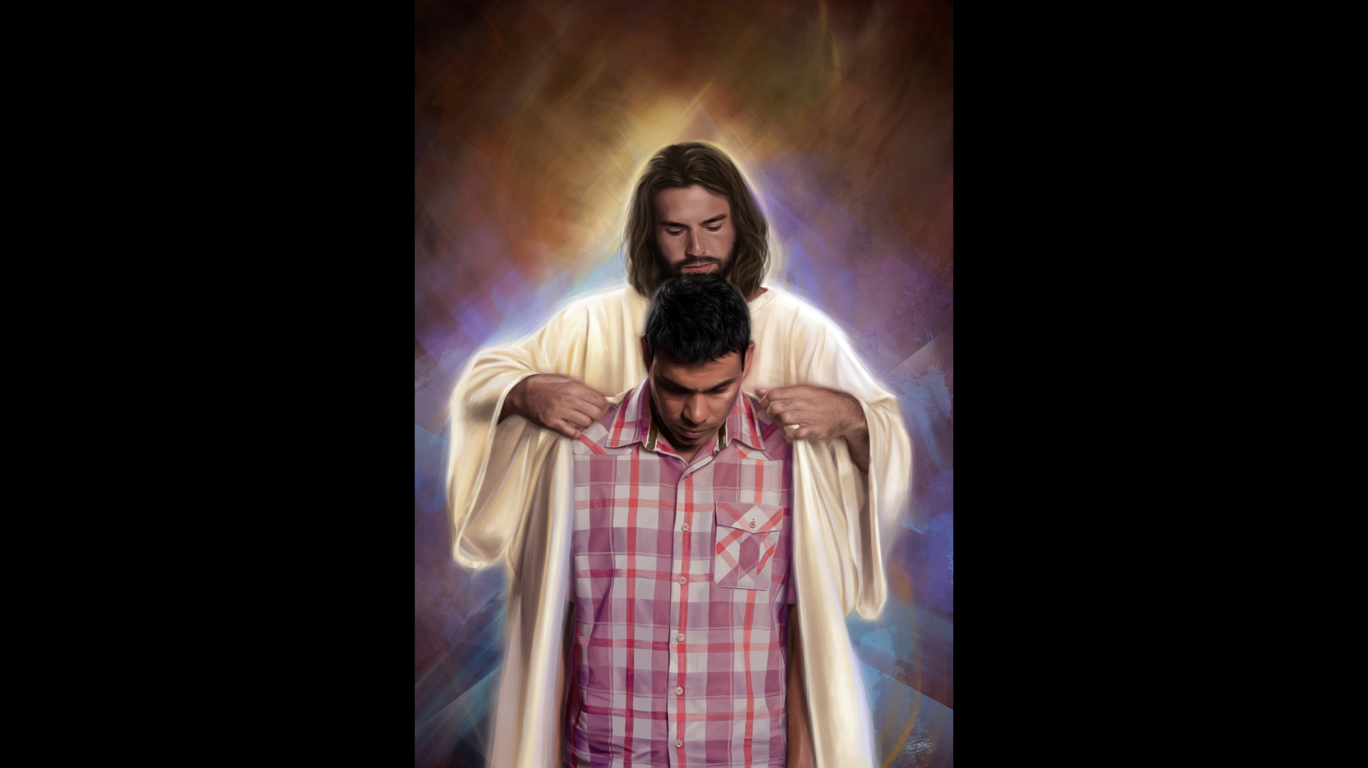
Next verse: Deuteronomy 6:6-8
Notes:
Symbolically, they have put on the “white garments”; ³ the “robe of righteousness”. ⁴ They are washed and made white “in the blood of the Lamb”. ⁵ This “robe of righteousness” is all about the perfect character that Jesus wants to give us. All our righteousness is “like filthy rags”, ⁶ but Jesus offers His perfection. When we give ourselves to Him, our heart is joined to His, our will merged in His, our thoughts submitted to Him. We live His life, in perfect obedience to His law. He can put His seal on us. Is this a visible mark?

Slide 46
Deuteronomy 6:6-8
(6) And these words which I command you today shall be in your heart. (7) You shall teach them diligently to your children, and shall talk of them when you sit in your house, when you walk by the way, when you lie down, and when you rise up. (8) You shall bind them as a ____ on your ____, and they shall be as frontlets between your ____.
Notes:
Deuteronomy 6:6-8
(6) And these words which I command you today shall be in your heart. (7) You shall teach them diligently to your children, and shall talk of them when you sit in your house, when you walk by the way, when you lie down, and when you rise up. (8) You shall bind them as a sign on your hand, and they shall be as frontlets between your eyes.

Slide 47
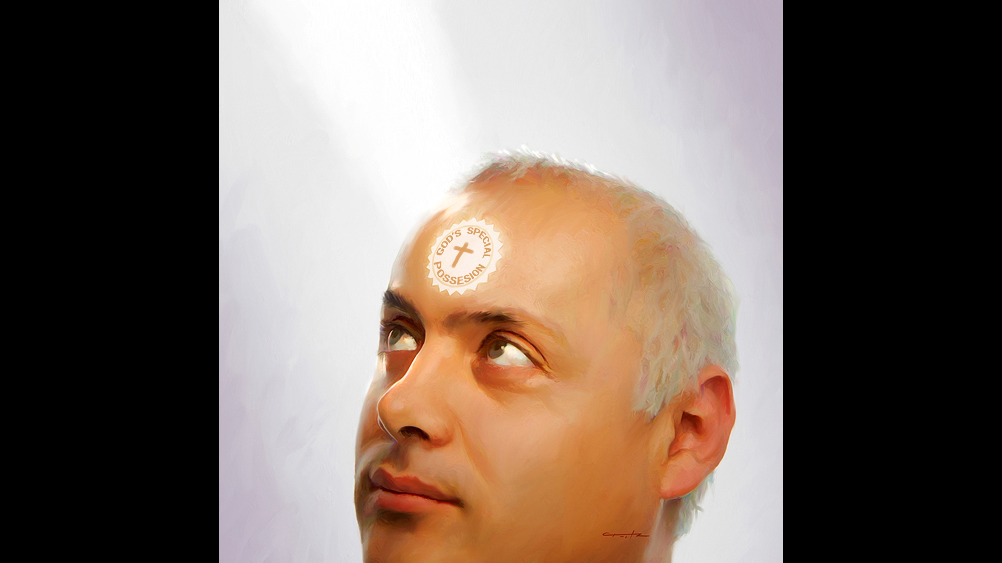
Next verse: Revelation 22:11,12
Notes:
The seal of God is put on those that are like Him in character. It is not a visible mark, but a state of mind and character that is fixed for eternity. The people who receive this seal are sold out to God, no matter the cost. They are safe to inhabit heaven. Jesus said, “They shall walk with Me in white, for they are worthy”.
What solemn pronouncement will Jesus make when the sealing is finished?

Slide 48
Revelation 22:11,12
“He who is ______, let him be unjust still; he who is ______, let him be filthy still; he who is _________, let him be righteous still; he who is ____, let him be holy still.”
(12) “And behold, I am coming quickly, and My reward is with Me, to give to every one according to his work.”
Notes:
Revelation 22:11,12
“He who is unjust, let him be unjust still; he who is filthy, let him be filthy still; he who is righteous, let him be righteous still; he who is holy, let him be holy still.”
(12) “And behold, I am coming quickly, and My reward is with Me, to give to every one according to his work.”

Slide 49
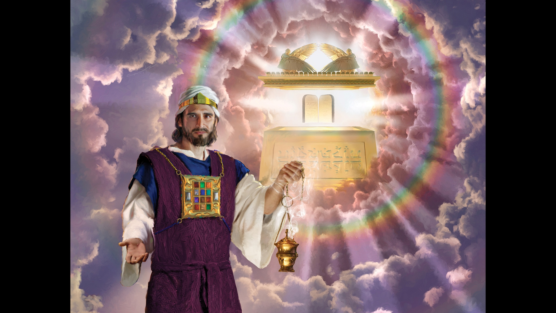
Next verse: Psalm 91:9-11,15
Notes:
When Jesus finishes His work in the heavenly sanctuary, everyone will have made their final decisions. There is no turning back, no flipping from one side to the other. Probation has closed. God’s people are sealed. Those who have not chosen to follow God have received the mark of the beast. Satan’s power is fully unleashed. The seven last plagues fall on the earth, and it is plunged into one great, final trouble.
Will God’s people be protected during this time?

Slide 50
Psalm 91:9-11,15
Because you have made the Lord, who is my refuge,
Even the Most High, your dwelling place, (10) no evil shall befall you, nor shall any ______ come near your dwelling; (11) For He shall give His ______ charge over you, to keep you in all your ways… (15) He shall call upon Me, and I will answer him; I will be with him in _______; I will deliver him and honor him.
Notes:
Psalm 91:9-11,15
Because you have made the Lord, who is my refuge, even the Most High, your dwelling place, (10) no evil shall befall you, nor shall any plague come near your dwelling; (11) For He shall give His angels charge over you, to keep you in all your ways… (15) He shall call upon Me, and I will answer him; I will be with him in trouble; I will deliver him and honor him.

Slide 51
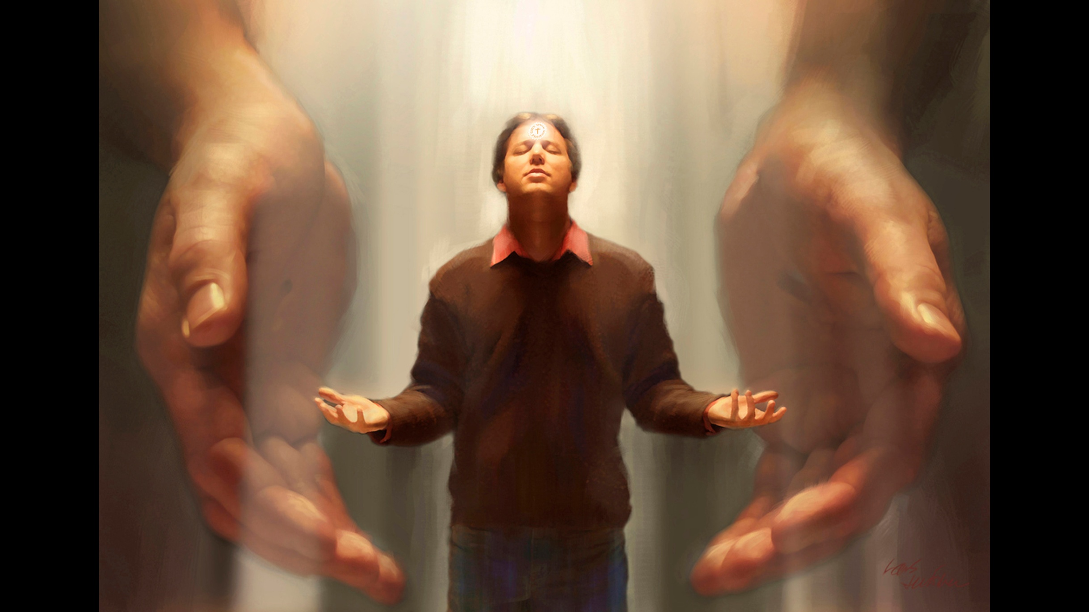
Next verse: Romans 12:1,2
Notes:
God will protect His people during the plagues. But the wicked will declare that the calamities falling on the world are the result of desecrating the first day of the week. They will finally pronounce a death decree on all who are faithful to God’s commandments. There will be “a time of trouble, such as never was…and at that time Your people shall be delivered, every one who is found written in the book.” ⁸
What should we be doing now to prepare for what is coming?

Slide 52
Romans 12:1,2
I beseech you therefore, brethren, by the mercies of God, that you present your bodies a living _________ holy, acceptable to God, which is your reasonable service. (2) And do not be conformed to this world, but be ___________ by the renewing of your mind, that you may prove what is that good and acceptable and perfect will of God.
Next verse: Philippians 2:12; 1 Timothy 6:12; 1 Peter 4:7; John 5:39
Notes:
Romans 12:1,2
I beseech you therefore, brethren, by the mercies of God, that you present your bodies a living sacrifice, holy, acceptable to God, which is your reasonable service. (2) And do not be conformed to this world, but be transformed by the renewing of your mind, that you may prove what is that good and acceptable and perfect will of God.

Slide 53
Philippians 2:12
...work out your own _________ with fear and trembling;
1 Timothy 6:12
Fight the good fight of _____, lay hold on eternal life…
1 Peter 4:7
...be serious and ________ …
John 5:39
...search the __________ …
Next verse: Mark 14:39; 11:22; Matthew 4:4; James 1:22
Notes:
Philippians 2:12
...work out your own salvation with fear and trembling;
1 Timothy 6:12
Fight the good fight of faith, lay hold on eternal life…
1 Peter 4:7
...be serious and watchful…
John 5:39
...search the Scriptures…

Slide 54
Mark 14:39
Watch and ____, lest you enter into temptation...
Mark 11:22
Have _____ in God.
Matthew 4:4
...live...by every word that proceeds from the mouth of ___.
James 1:22
...be _____ of the word, and not hearers only...
Notes:
Mark 14:39
Watch and pray, lest you enter into temptation...
Mark 11:22
Have faith in God.
Matthew 4:4
...live...by every word that proceeds from the mouth of God.
James 1:22
...be doers of the word, and not hearers only...

Slide 55
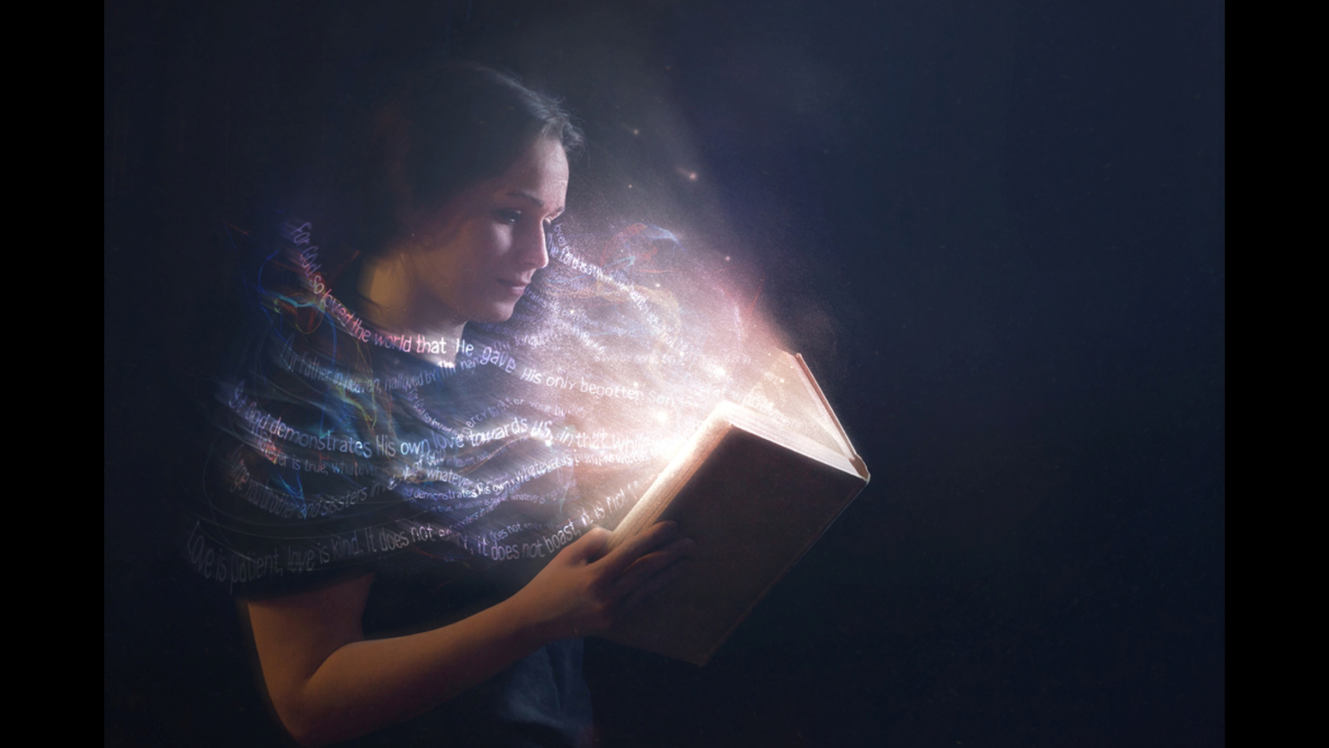
Notes:
Now is the time to fill our whole mind with the word of God, to pray like never before, to exercise faith in God. He alone can get us through the times ahead. He is coming soon!
Will you determine to be faithful to God no matter what?

Slide 56
REFERENCES
1) Romans 6:4
2) Revelation 19:9
3) Revelation 3:18
4) Isaiah 61:10
5) Revelation 7:14
6) Isaiah 64:6
7) Revelation 3:4
8) Daniel 12:1
Notes:
1) Romans 6:4
2) Revelation 19:9
3) Revelation 3:18
4) Isaiah 61:10
5) Revelation 7:14
6) Isaiah 64:6
7) Revelation 3:4
8) Daniel 12:1.

